Slide 1
Finding the Subnet, Broadcast and Useable Host Ranges
Lecture 4
Finding the Subnet, Broadcast and Useable Host Ranges

Slide 2
Introduction
Determining the Network, Broadcast and useable Host range in obviously important when designing an IP scheme.
It is important to chart the usable IP ranges as well as plan for future growth.
We start by determining whether you are working with a Class A, B or C address.
Create your chart with the SNM (Subnet Mask) on the first line and your IP address on the second line.
Label the left column with the appropriate titles of what you are trying to determine which are the
  Subnet Address
  Broadcast Address
  Last and first Usable host

Slide 3
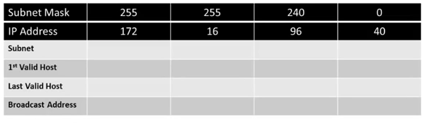
Step 1
Draw the table and insert the IP address and SNM

Slide 4
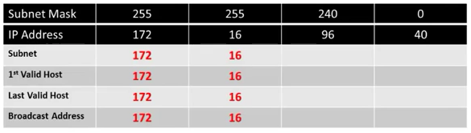
Step 2
Determining the ‘255’ octet range.
With any SNM octet of 255, you bring down the octets in the IP Address since this part of the IP address will not change.

Slide 5
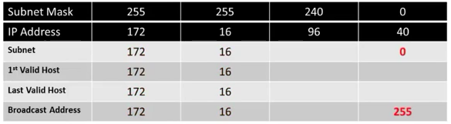
Step 3
Determine the ‘0’ octet range.
The 4th octet in the SNM is 0. We know that for a ‘0’octet the range is 0-255. We simply place the 0 in the Subnet Address space and the 255 in the Broadcast Address space.

Slide 6
Step 4
Determine the subnet address
To determine the Subnet, we have to find the missing number. To do this we subtract the non 0/255 octet number from 256; in this case the number is 240. This will give us our “magic” number 256-240=16. 16 is our “magic” number.
We now increment starting at 0 using 16. What we are looking for is a number that is either equal to but not greater then 96, (in this case the 3rd octet in the IP Address.)
0-16-32-48-64-80-96-112…
As you can see, 96≤112, so it goes into the empty octet completing the Subnet address. If the number had been anything between 96-111, our subnet would still be 96.

Slide 7
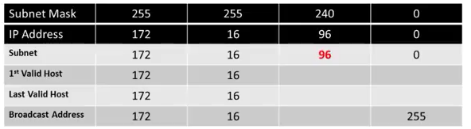
Step 4-Cont.

Slide 8
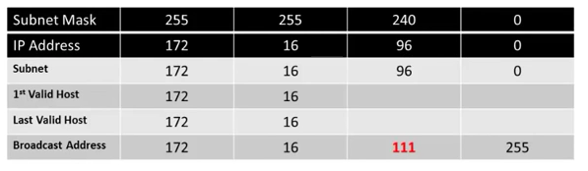
Step 5
Determine the Broadcast address.
To determine the Broadcast address we look at the range of the 96 subnet.
Since the last bit in the 96 subnet is 111, our broadcast address is 111.

Slide 9
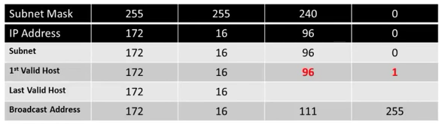
Step 6
Determine the 1st valid Host range.
To determine the 1st valid Host range, start with the Subnet address and bring down the 3rd octet of 96. Then bring down the last octet and add 1. (0+1=1)
This (172.16.96.1) is the first valid host for the subnet 172.16.96.0.

Slide 10
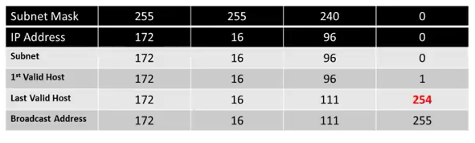
Step 7
Determine the last valid Host range.
To determine the last valid Host, start with the Broadcast address and move up the 3rd octet of 111 and the last octet while subtracting 1. (255-1)
This, (172.16.111.254) is the last valid host for the subnet 172.16.96.0
The host range for the subnet is 172.16.96.1 to 172.16.111.254

Slide 11
Class Work 1
Subnet Mask | 255 | 248 | 0 | 0
IP Address | 10 | 30 | 200 | 16
Subnet
1st valid Host
Last Valid Host
Broadcast Address

Slide 12
Class Work 1
Subnet Mask | 255 | 248 | 0 | 0
IP Address | 10 | 30 | 200 | 16
Subnet | 10 | 24 | 0 | 0
1st valid Host | 10 | 24 | 0 | 1
Last Valid Host | 10 | 31 | 255 | 254
Broadcast Address | 10 | 31 | 255 | 255

Slide 13
Class Work 2
Subnet Mask | 255 | 255 | 255 | 224
IP Address | 172 | 16 | 47 | 36
Subnet
1st valid Host
Last Valid Host
Broadcast Address

Slide 14
Class Work 2
Subnet Mask | 255 | 255 | 255 | 224
IP Address | 172 | 16 | 47 | 36
Subnet | 172 | 16 | 47 | 32
1st valid Host | 172 | 16 | 47 | 33
Last Valid Host | 172 | 16 | 47 | 62
Broadcast Address | 172 | 16 | 47 | 63

Slide 15
Class Work 3
Subnet Mask | 255 | 255 | 255 | 192
IP Address | 192 | 168 | 75 | 150
Subnet
1st valid Host
Last Valid Host
Broadcast Address

Slide 16
Class Work 3
Subnet Mask | 255 | 255 | 255 | 192
IP Address | 192 | 168 | 75 | 150
Subnet | 192 | 168 | 75 | 128
1st valid Host | 192 | 168 | 75 | 129
Last Valid Host | 192 | 168 | 75 | 190
Broadcast Address | 192 | 168 | 75 | 191

Slide 17
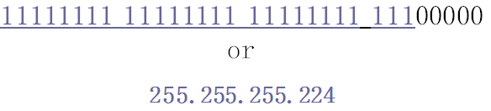
Problem
A company is granted the site address 201.70.64.0 (class C). The company needs six subnets. Design the subnet.
Solution
The company needs six subnets. This number 6 is not a power of 2. The next number that is a power of 2 is 8 (2³). We need 3 more 1s in the subnet mask. The total number of 1s in the subnet mask is 27 (24 + 3).
The total number of 0s is 5 (32 - 27). The subnet mask is

Slide 18
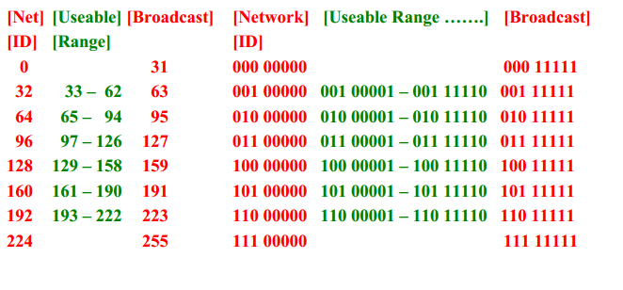
Cont.
The number of addresses in each subnet is 2⁵ (5 is the number of 0s) or 32.

Slide 19
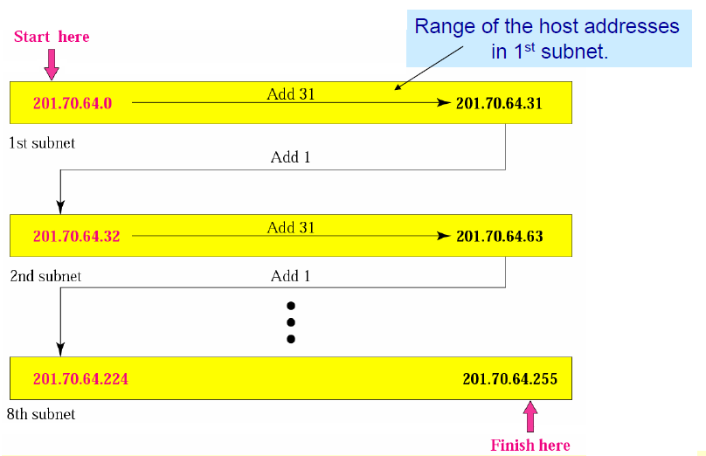
Cont.

Slide 20
Problem
You are given two address / mask combinations, written with the prefix/length notation, which have been assigned to two devices. Your task is to determine if these devices are on the same subnet or different subnets. You can do this by using the address and mask of each device to determine to which subnet each address belongs.
Device A: 172.16.17.30/20 Device B: 172.16.28.15/20
Solution
First 20 bits of the address represent network address.
given ip addresses are 172.16.17.30 and 172.16.28.15
both ip address are considered to be in same network if anf only if first 20 bits of both the ip address are same.

Slide 21
Solution
Here first two octets of both ip's(172.16) are same. so, first 16 bits are already same.
so, now we need to check the first 4 bits of 3rd octet(17 and 28). if they are same then they belong to same network.
17 in binary is 00010001
28 in binary is 00011100
first 4 bits of 17 and 28 is 0001 and hence first 20 bits of both the ip addresses are same.
hence, these ip addresses are in the same subnet.

Slide 22
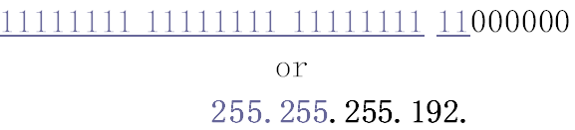
Problem
A company is granted the site address 181.56.0.0 (class B). The company needs 1000 subnets. Design the subnets.
Solution
The number of 1s in the default mask is 16 (class B).
The company needs 1000 subnets. This number is not a power of 2. The next number that is a power of 2 is 1024 (2¹⁰). We need 10 more 1s in the subnet mask. The total number of 1s in the subnet mask is 26 (16 + 10).
The total number of 0s is 6 (32 - 26).
The subnet mask is

Slide 23
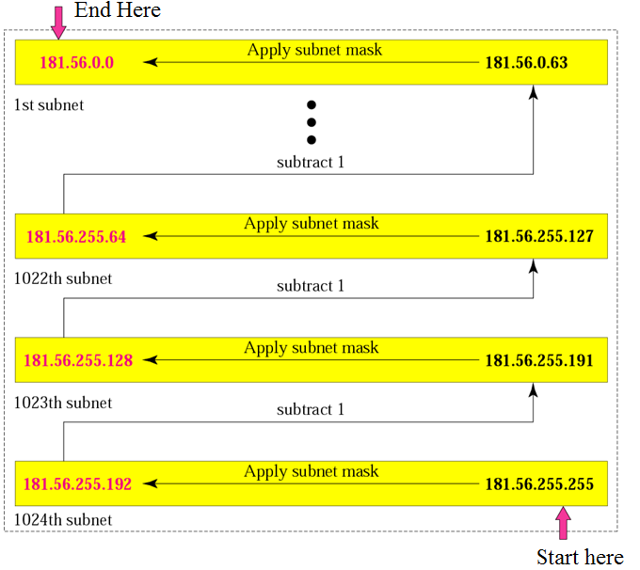
Cont.
The number of subnets is 1024.
The number of addresses in each subnet is 2⁶ (6 is the number of 0s) or 64.

